Slide 1
CMPE 297:Assignment 1-Part 2
Name: Nevil Shah
SJSU ID: 015964975

Slide 2
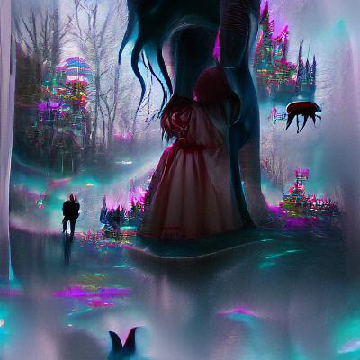
Creator nightcafe studio
Link to the website: https://creator.nightcafe.studio/my-creations Keyword: wonderland

Slide 3
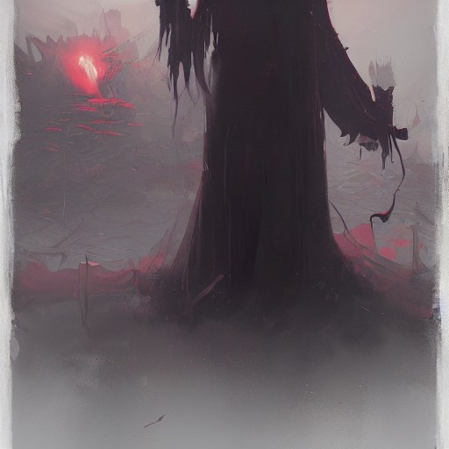
Changed the mode to artistic and the modified version of the previous image is:

Slide 4
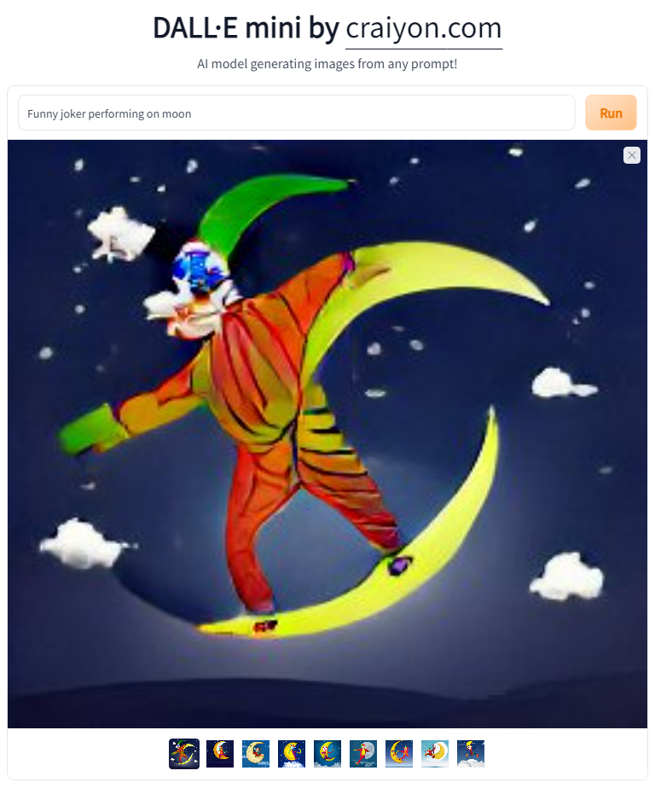
2) Dall-e-mini
Link to the website: https://huggingface.co/spaces/dalle-mini/dalle-mini Keyword: Funny joker performing on moon

Slide 5
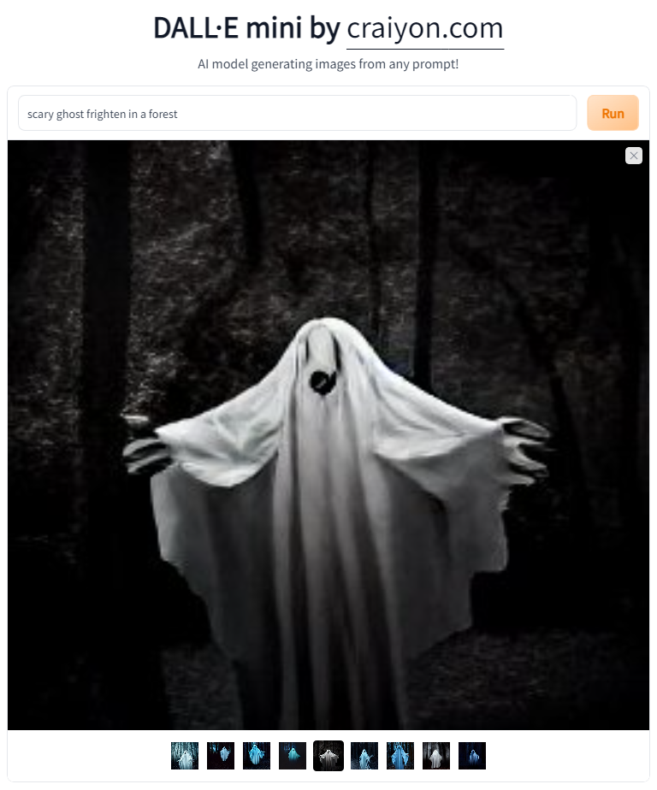
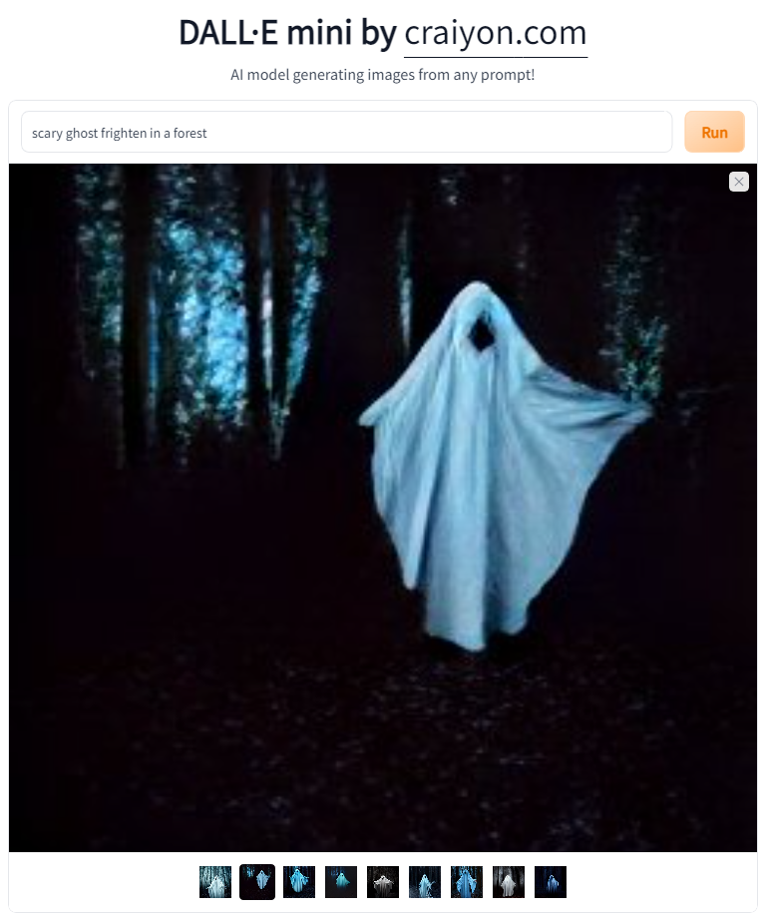
Keyword: scary ghost frighten in a forest

Slide 6
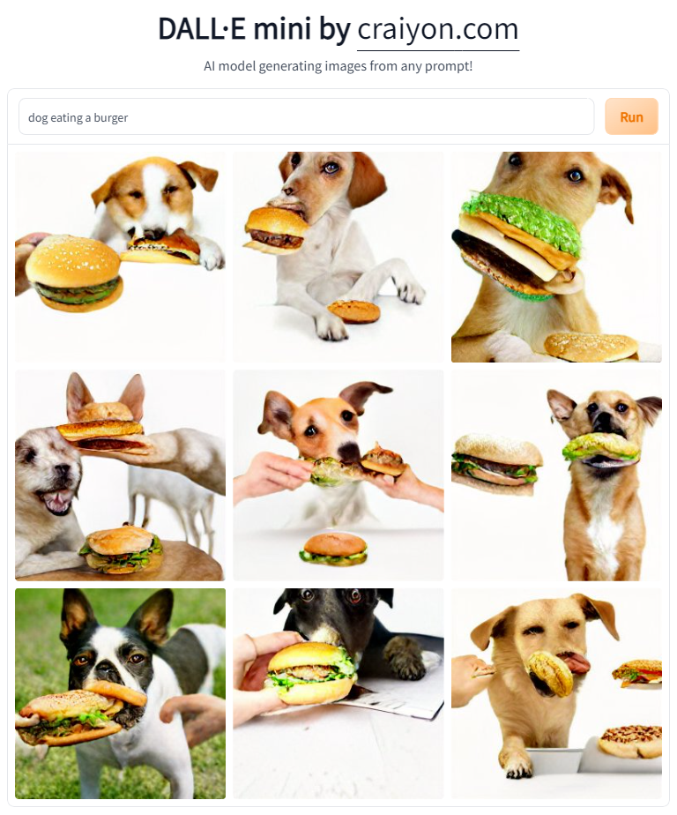
Keyword: dog eating a burger

Slide 7
3) Pixray
Link to the website: https://replicate.com/pixray/text2image

Slide 8
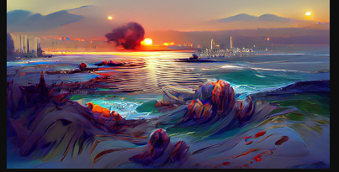
Keyword: Pacific ocean at Sunset

Slide 9
4) Hugging Face (BigScience/Bloom)
Link to the website: https://huggingface.co/bigscience/bloom

Slide 10
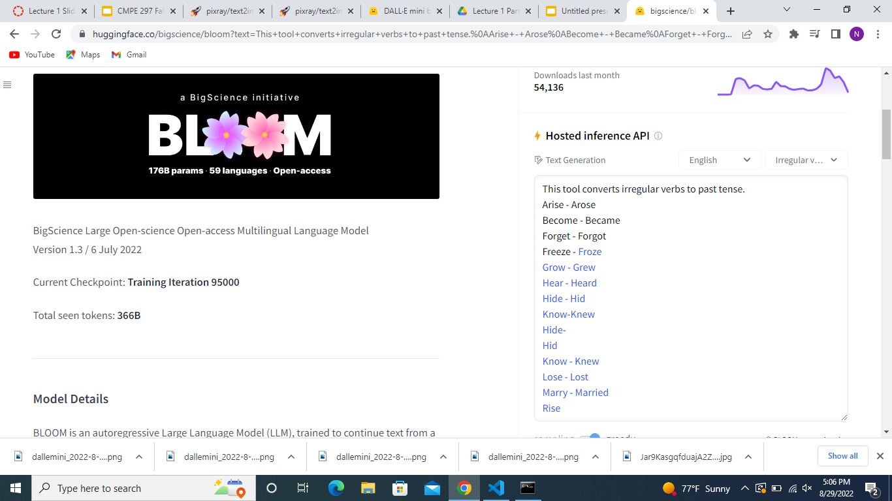
Changing into past tense:

Slide 11
Thank you

